Slide 1

Nice Classification
Toni Polson Ashton

Slide 2


Slide 3

Class Headings

Slide 4
Class Headings

Slide 5

Class Headings

Slide 6
Class Headings

Slide 7

Class Headings

Slide 8
Class Headings

Slide 9

Class Headings

Slide 10
Class Headings

Slide 11

Class Headings

Slide 12
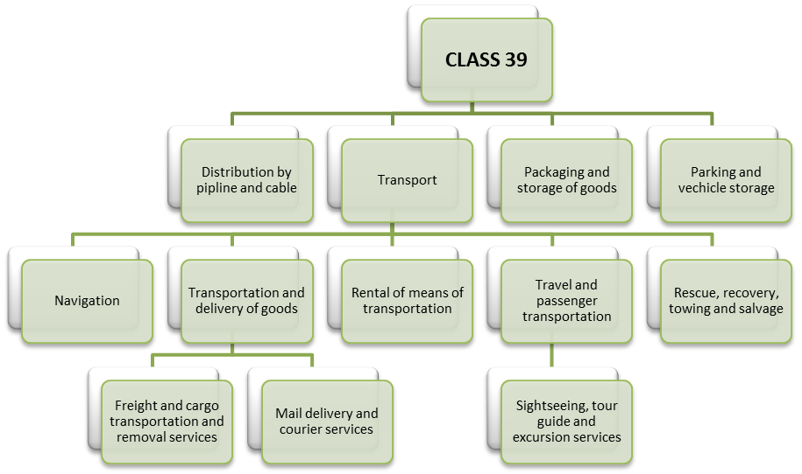
Class 39 Hierarchy
Figure 1. Class 39, Excerpted from Taxonomy. The goods and services of the NLC Class 39 have been placed into a hierarchy with the headings above

Slide 15


Slide 16


Slide 17
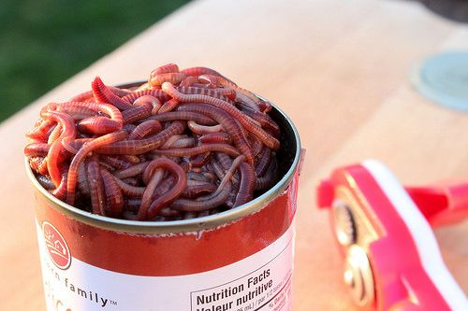

Slide 18

Treaty Changes
Clause 3(1)(a)(xv) of the Singapore Treaty should be struck out. Clause 3(1)(a)(xv) would then read to the effect of:
3(1)(a) Any Contracting Party may require that an application contain some or all of the following indications or elements: … (xv) the names of the goods and/or services for which the registration is sought, grouped according to the classes of the Nice Classification, each group preceded by the number of the class of that Classification to which that group of goods or services belongs and presented in the order of the classes of the said Classification;…
Clause 3(2) of the Madrid Protocol should be amended to read:
3(2) The applicant must indicate the goods and services in respect of which protection of the mark is claimed and also, if possible, the corresponding class or classes according to the classification established by the Nice Agreement Concerning the International Classification of Goods and Services for the Purposes of the Registration of Marks. If the applicant does not give such indication, the International Bureau shall classify the goods and services in the appropriate classes of the said classification. The indication of classes given by the applicant shall be subject to control by the International Bureau, which shall exercise the said control in association with the Office of origin. In the event of disagreement between the said Office and the International Bureau, the opinion of the latter shall prevail.

Slide 19


Slide 20
Thank you

